Slide 1

Ruby on Rails

Slide 2
About today…
Ruby on Rails
Integrating third party APIs

Slide 3
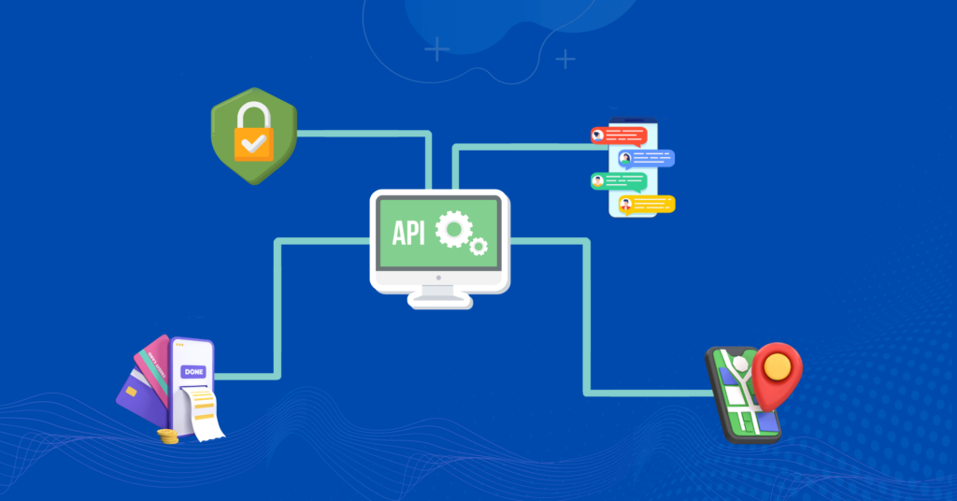
Integrating Third-party APIs in Rails

Slide 4
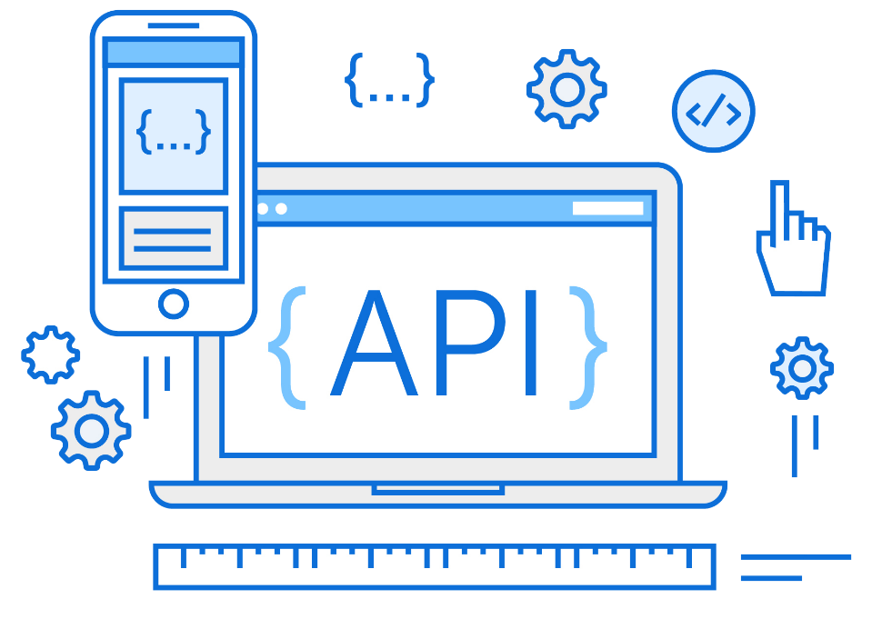
Introduction to APIs
Definition
Application Programming Interface
Purpose
Allows different software applications to communicate
Examples
Weather APIs, Payment Gateways, Social Media APIs

Slide 5

Why Use Third-party APIs?
Save development time
Leverage data from other Providers
Focus on core functionality
Scalability and Reliability

Slide 6
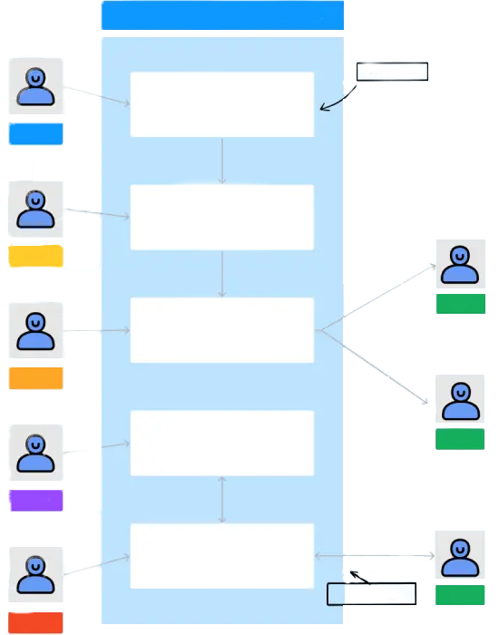
Common Use Cases in Rails
↓
Authentication
OAuth
OpenID
↓
Payment Processing
Stripe
PayPal
↓
Data Fetching
Twitter
Google Maps
↓
Notifications
Twilio
SendGrid

Slide 7


Setting Up a New Rails Project
Creating a New Rails Project
Command
rails new api_integration_demo
Navigate
Navigate to Project Directory
Dependencies
Install Dependencies

Slide 8
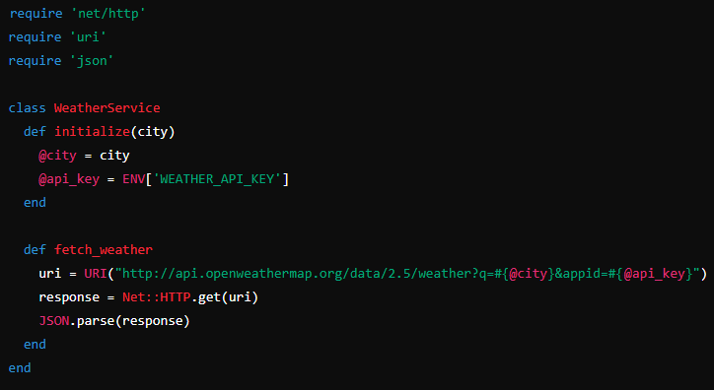
Making HTTP Requests in Rails
Use Ruby's built-in Net::HTTP library
Example
Fetch Weather Data
Explanation
URI construction, Net::HTTP.get method, JSON parsing

Slide 9



Configuring Environment Variables
Create .env file in the root directory
Add API keys and secrets
Load environment variables in Rails by adding to config/application.rb

Slide 10

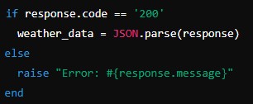
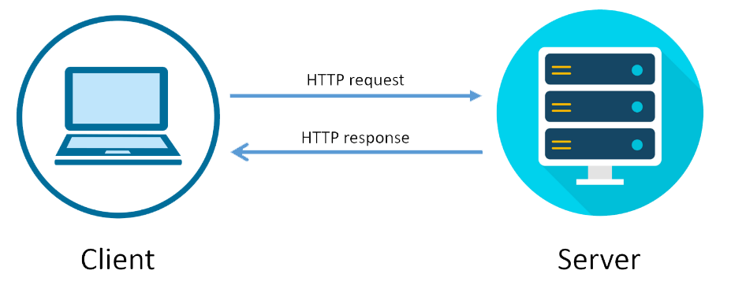
Handling API Responses
Parse JSON Response
Load environment variables in Rails by adding to config/application.rb
Error Handling

Slide 11
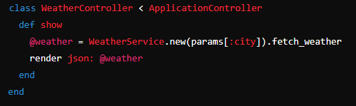
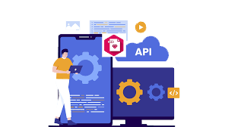

Integrating with a Controller
Example
Controller Action
Routes Configuration

Slide 12

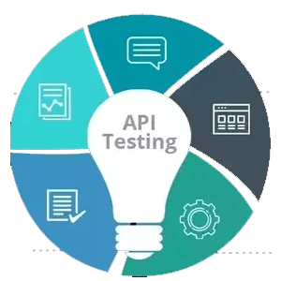
Testing the integration
Using Postman or Curl to Test API Endpoint

Slide 13


Slide 14

What does API stand for?
Application Programming Interface
Which Ruby library is commonly used for making HTTP requests in Rails without third-party gems?
Net::HTTP
How do you parse a JSON response in Ruby?
JSON.parse(response)
What file is typically used to store environment variables in a Rails application?
.env
In Rails, how do you define a route for a show action in a controller?
get '/weather/ ', to: 'weather#show'

Slide 15

Task 1
Create a Rails application that fetches data from a public API and displays it
Task 2
Enhance the API integration by adding error handling and displaying data on a view.

